Slide 1
Exponential and fractional column headings
Place value

Slide 2
how to use Oak lessons

Slide 3
I can express place value column headings using both exponential and fractional representations.

Slide 4

When a number is multiplied by itself multiple times, it can be written more simply in exponential form.
e.g.
A number is in fractional form when it is displayed as one integer divided by another integer.
e.g.

Slide 5

Exponential and fractional column headings
Place value headings expressed in exponential form
Place value headings expressed in fractional form

Slide 6
Place value headings expressed in exponential form
What do these numbers have in common?
1
10
100
1000
10 000
100 000
1 000 000
They are all powers of ten.
10 × 10
10 × 10 × 10
10 × 10 × 10 × 10
10 × 10 × 10 × 10 × 10
10 × 10 × 10 × 10 × 10 × 10

Slide 7
Place value headings expressed in exponential form
When a number is multiplied by itself multiple times, it can be written more simply in exponential form.
e.g.

Slide 8
Place value headings expressed in exponential form
Number | Expanded form | Exponential form
1
10
100 | 10 × 10
1000 | 10 × 10 × 10
10 000 | 10 × 10 × 10 × 10
100 000 | 10 × 10 × 10 × 10 × 10
1 000 000 | 10 × 10 × 10 × 10 × 10 × 10
10⁰
What goes in these positions?
10¹
10²
10³
10⁴
10⁵
10⁶

Slide 9
Place value headings expressed in exponential form
Number | Expanded form | Exponential form
1
10
100 | 10 × 10
1000 | 10 × 10 × 10
10 000 | 10 × 10 × 10 × 10
100 000 | 10 × 10 × 10 × 10 × 10
1 000 000 | 10 × 10 × 10 × 10 × 10 × 10
10⁰
What do we write here?
10¹
10²
10³
10⁴
10⁵
10⁶

Slide 10
Place value headings expressed in exponential form
Number | Expanded form | Exponential form
1
10
100
1000
10 000
100 000
1 000 000
1
10⁰
What do we write here?
1 × 10
10¹
1 × 10 × 10
10²
1 × 10 × 10 × 10
10³
1 × 10 × 10 × 10 × 10
10⁴
1 × 10 × 10 × 10 × 10 × 10
10⁵
1 × 10 × 10 × 10 × 10 × 10 × 10
10⁶

Slide 11

Place value headings expressed in exponential form
Exponential form is a way of writing repeated ?
addition of the same value
subtraction of the same value
multiplication of the same value
division of the same value

Slide 12
Place value headings expressed in exponential form
What is the value of 1000 in exponential form?
10⁴
10³
10 x 3
10 x 10 x 10

Slide 13
Place value headings expressed in exponential form
We can express the place value headings in exponential form.
M | HTh | TTh | Th | H | T | O
1 000 000 | 100 000 | 10 000 | 1000 | 100 | 10 | 1
10⁶
10⁵
10⁴
10³
10²
10¹
10⁰

Slide 14
Place value headings expressed in exponential form
What is missing from this place value chart?
M | HTh | TTh | Th | H | T | O
1 000 000 | 100 000 | 10 000 | 1000 | 100 | 10 | 1
10⁶
.
10⁵
.
10⁴
10³
10²
.
10¹
.
10⁰

Slide 15
Place value headings expressed in exponential form
What is the value of each digit in this number?
8352
8000
300
50
2
8 × 1000
3 × 100
5 × 10
2 × 1
8 × 10³
3 × 10²
5 × 10¹
2 × 10⁰
eight thousands
three hundreds
five tens
two ones

Slide 16
Place value headings expressed in exponential form
What is missing from the composition of this number?
4935
4000
900
30
5
4 × 1000
9 × 100
3 × 10
5 × 1
4 × 10³
9 × 10²
3 × 10¹
5 × 10⁰
four thousands
nine hundreds
three tens
five ones

Slide 17
Place value headings expressed in exponential form
What is this number?
8 × 10³ +
2 × 10² +
7 × 10¹ +
6 × 10⁰
8276
HTh | TTh | Th | H | T | O
10⁵
10⁴
10³
10²
10¹
10⁰
8
2
7
6

Slide 18
Place value headings expressed in exponential form
What is this number?
8 × 10⁵
+
2 × 10⁴
+
7 × 10³
+
6 × 10⁰
827 006
HTh | TTh | Th | H | T | O
10⁵
10⁴
10³
10²
10¹
10⁰
8
2
7
0
0
6

Slide 19

Place value headings expressed in exponential form
What is this number?
8 × 10⁶ +
2 × 10⁵ +
7 × 10⁴ +
6 × 10³
Alex writes this.
8276
8 276 000
He has just written the digits 8, 2, 7 and 6 in order. He hasn’t considered the place value.
What has Alex done wrong?

Slide 20
Place value headings expressed in exponential form
1) Fill in the blanks.
Number | Exponential form
1
10
100
1000
10 000
100 000
1 000 000
10²

Slide 21
Place value headings expressed in exponential form
2) Fill in the blanks.
372 500
2 × 10³
3) Write these numbers.
2 × 10³ + 5 × 10² + 8 × 10¹ + 4 × 10⁰
4 × 10⁶ + 8 × 10⁵ + 3 × 10⁴
4 × 10⁶ + 8 × 10³ + 3 × 10⁰

Slide 22
Place value headings expressed in exponential form
1) Fill in the blanks.
Number | Exponential form
1
10
100
1000
10 000
100 000
1 000 000
10⁰
10¹
10²
10³
10⁴
10⁵
10⁶

Slide 23
Place value headings expressed in exponential form
2) Fill in the blanks.
372 500
3 × 10⁵
7 × 10⁴
2 × 10³
5 × 10²
3) Write these numbers.
2 × 10³ + 5 × 10² + 8 × 10¹ + 4 × 10⁰
2584
4 × 10⁶ + 8 × 10⁵ + 3 × 10⁴
4 830 000
4 × 10⁶ + 8 × 10³ + 3 × 10⁰
4 008 003

Slide 24
Exponential and fractional column headings
Place value headings expressed in exponential form
Place value headings expressed in fractional form

Slide 25

Place value headings expressed in fractional form
Follow this pattern.
1
× 10
10
× 10
100
× 10
What is happening?
1000
× 10
10 000
× 10
100 000

Slide 26
Place value headings expressed in fractional form
Follow this pattern.
1000
÷ 10
100
÷ 10
10
What is happening now?
÷ 10
1
÷ 10
0.1
What is next?
÷ 10
0.01
÷ 10
0.001

Slide 27



Place value headings expressed in fractional form
1000
1000
100
100
integers
10
10
1
1
0.1
0.01
non-integers
0.001

Slide 28
Place value headings expressed in fractional form
0.01 and have different values.
_1_
100
One is a decimal, one is a fraction.
They both have the value “one one hundredth of one”.

Slide 29
Place value headings expressed in fractional form
Thousands
Hundredths
Thousandths
Hundreds
Ones
Tenths
Tens
Th
H
T
O
t
h
th
10³
10²
10¹
10⁰
A number is in fractional form when it is displayed as one
integer divided by another integer.

Slide 30


Place value headings expressed in fractional form
Fill in the missing headings in this place value chart.
Thousandths
Tens of thousandths
Hundreds of thousandths
Hundredths
Ones
Tenths
Tens
T
O
t
h
th
tth
hth
10¹
10⁰

Slide 31
Place value headings expressed in fractional form
Thousands
Hundredths
Thousandths
Hundreds
Ones
Tenths
Tens
Th
H
T
O
t
h
th
10³
10²
10¹
10⁰
8
0
0
Eight hundreds
8 × 100 = 8 x 10²

Slide 32

Place value headings expressed in fractional form
Thousands
Hundredths
Thousandths
Hundreds
Ones
Tenths
Tens
Th
H
T
O
t
h
th
10³
10²
10¹
10⁰
0
0
8
Eight hundredths
8 ×
=
= 0.08

Slide 33



Place value headings expressed in fractional form
What is the value of each digit in this number?
0.352
0.3
0.05
0.002
three tenths
five hundredths
two thousandths
3 ×
5 ×
2 ×

Slide 34



Place value headings expressed in fractional form
Write the value of the digits 6 and 3 in this number in fractional form.
0.4603

Slide 35
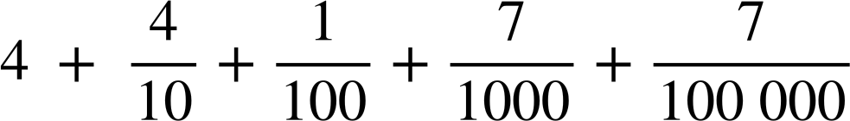
Place value headings expressed in fractional form
1) Write the value of each non-zero digit in fractional form.
0.01204
2) Write this number in decimal form.

Slide 36
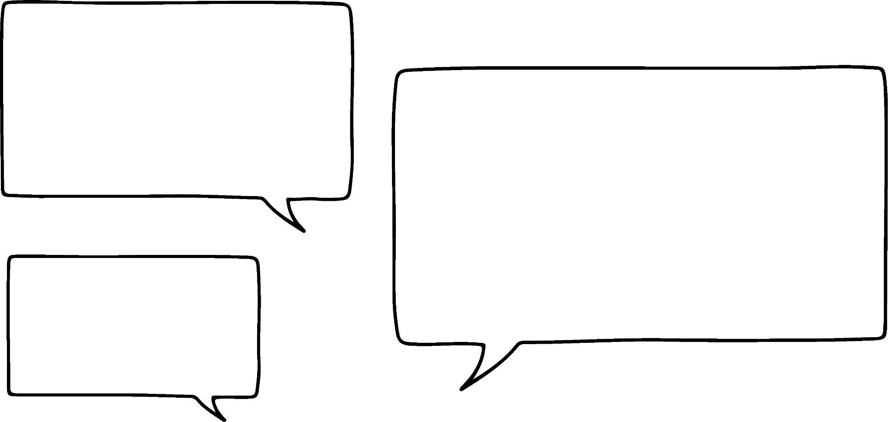

Place value headings expressed in fractional form
3)
300 is bigger than 30. There are more zeros. That’s why 0.03 is bigger than 0.3
Justify, by referring to fractional form, why Jun is
wrong.

Slide 37

Place value headings expressed in fractional form
1) Write the value of each non-zero digit in fractional form.
0.01204
2) Write this number in decimal form.
4.41707

Slide 38

Place value headings expressed in fractional form
3)
300 is bigger than 30. There are more zeros. That’s why 0.03 is bigger than 0.3
Justify, by referring to fractional form, why Jun is wrong.
Your explanation might have included 0.3 > 0.03 because
>
Tenths are bigger than hundredths.

Slide 39
Exponential and fractional column headings
Place value headings like thousands, hundreds, tens, ones can be written in exponential form.
e.g. 10³, 10², 10¹, 10⁰
Non-integer place value headings like tenths,
hundredths and thousandths can be written in
fractional form.
e.g. , ,

Slide 40

© Oak National Academy 2023.
Produced in partnership with Mathematics in Education and Industry.
Licensed on the Open Government Licence v3.0, except where otherwise stated. See Oak terms and conditions.

